Slide 1
Breast Cancer Diagnosis using ML models
Yue Hou
7-13-2017

Slide 2
ML models to predict breast cancer
Breast cancer for women:
1/3 of cancer patients,
2nd leading cause of death
Early detection: more likely to cure
Wisconsin data set from Kaggle/UCI:
19/50 rank for estimated new cases and deaths in 2017
Well-studied
https://www.kaggle.com/uciml/breast-cancer-wisconsin-data

Slide 3
Goals
Select a good model among 4 classification models:
Rank important features for future diagnosis/interpretation
Models | Methods in “caret” R
Logistic Regression | glm
Classification Tree | rpart
Random Forest | rf
SVM | svmRadial

Slide 4
Data Structure
nrows = 569 sample images;
ncols = 30 variables + 1 diagnosis outcome
Diagnosis | radius_mean | texture_mean | perimeter_mean | area_mean | smoothness_ mean | compactness_ mean | concavity_mean | concave.points_mean | symmetry_mean | fractal_ dimension_mean
radius_se | texture_se | perimeter_se | area_ se | smoothness_ se | compactness_ se | concavity_se | concave.points_ se | symmetry_se | fractal_ dimension_se
radius_worst | texture_worst | perimeter_worst | area_ worst | smoothness_ worst | compactness_ worst | concavity_worst | concave.points_ worst | symmetry_worst | fractal_ dimension_worst

Slide 5
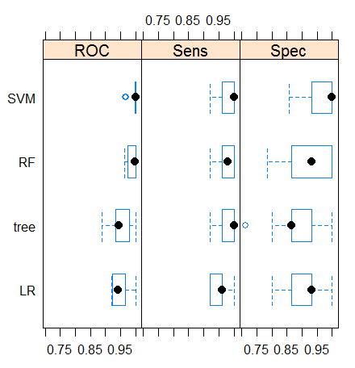
Model Selection: SVM
Average of 10 resamples data set
Test Data | LR | Tree | RF | SVM
Sensitivity | 0.9047619 | 0.9047619 | 0.9206349 | 0.9682540
Specificity | 0.9439252 | 0.9439252 | 0.9626168 | 0.9626168
Pos Pred Value | 0.9047619 | 0.9047619 | 0.9354839 | 0.9384615
Neg Pred Value | 0.9439252 | 0.9439252 | 0.9537037 | 0.9809524

Slide 6
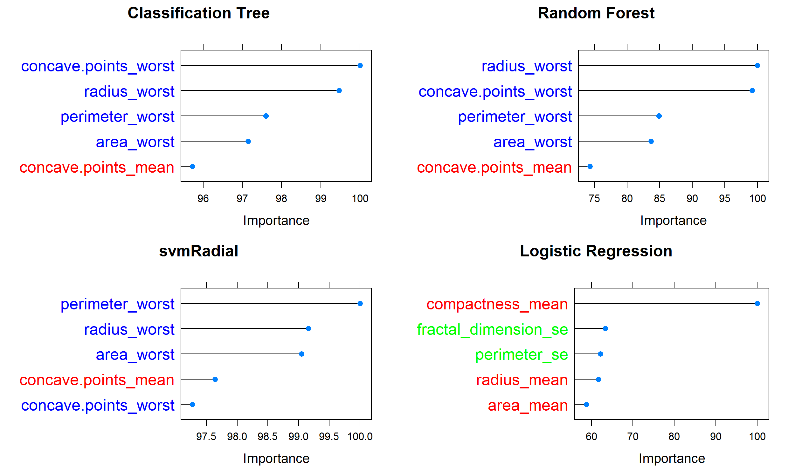
Rank Predictors: “_worst” set is important

Slide 7
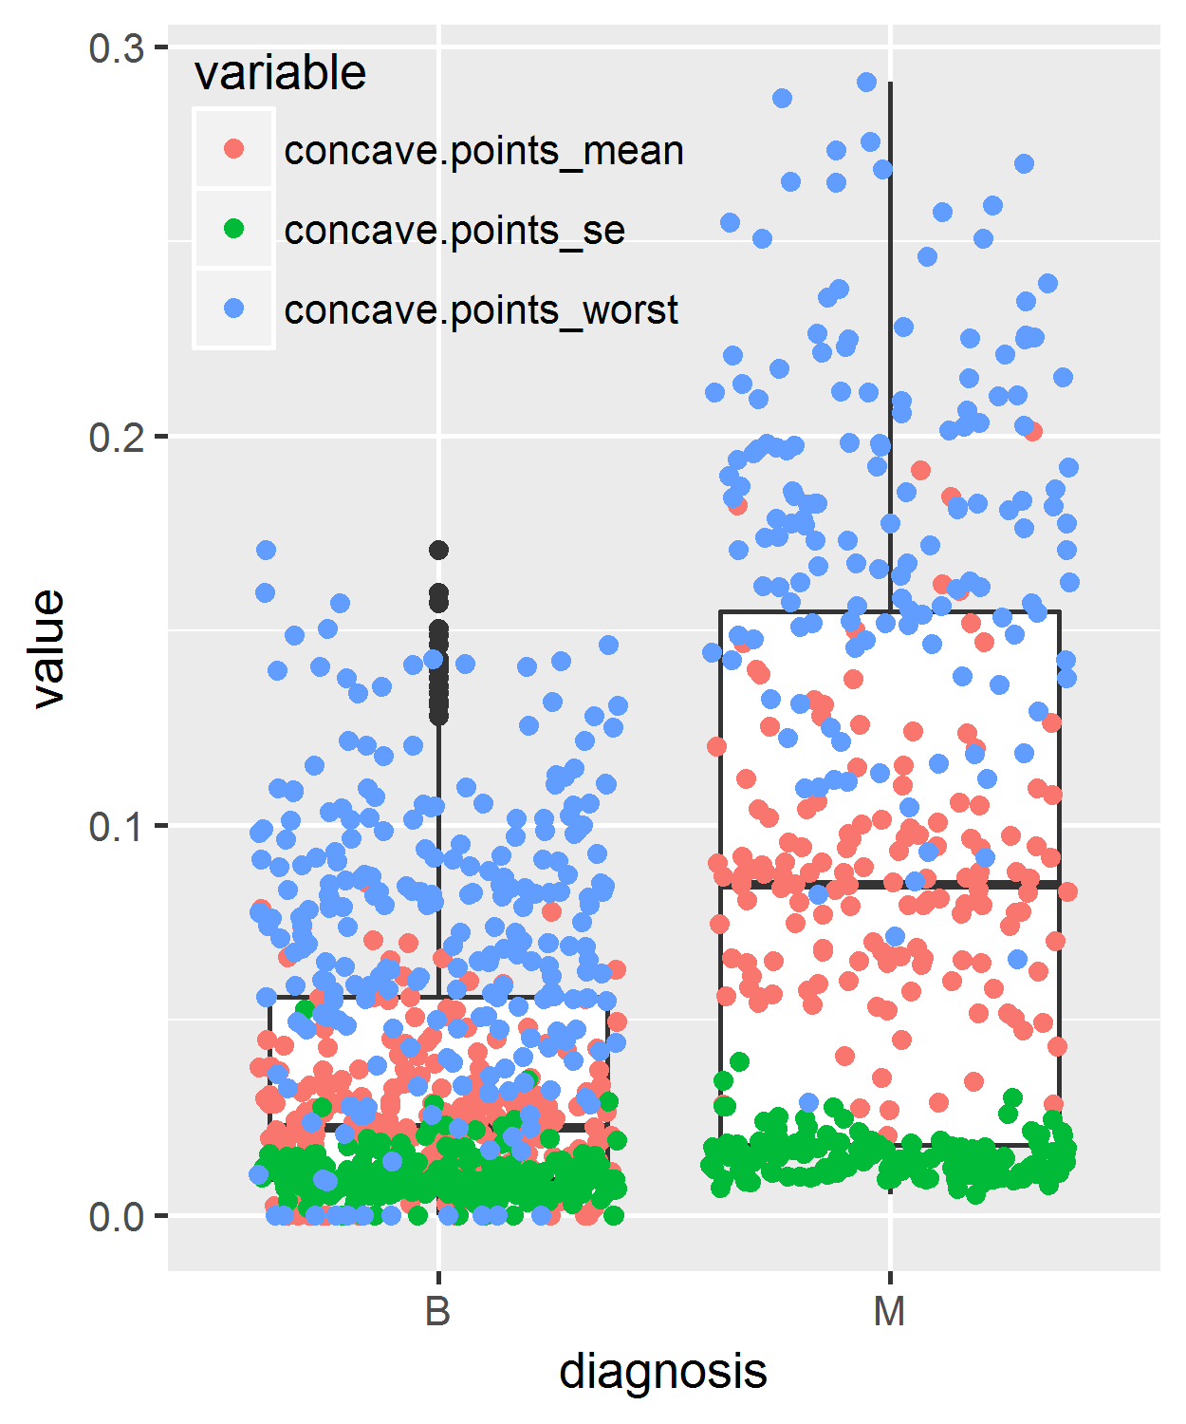
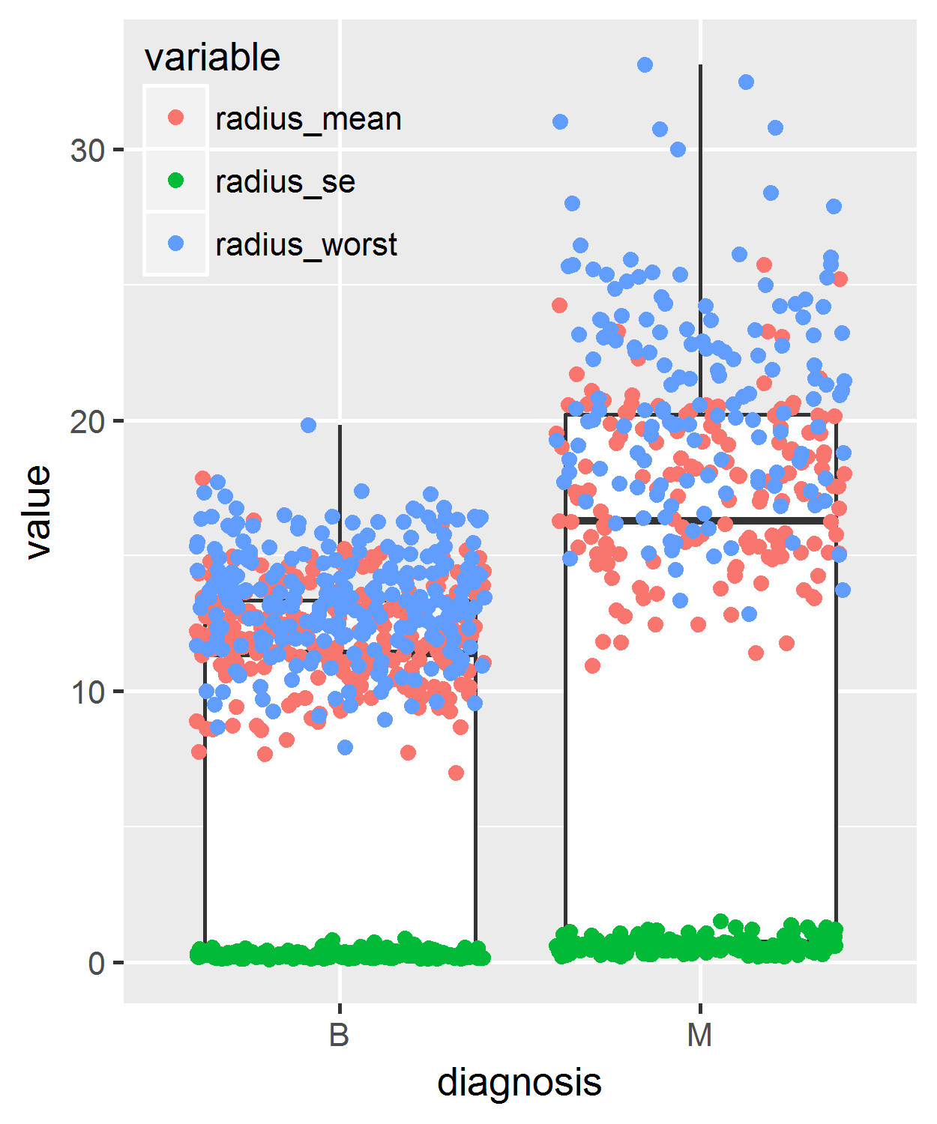
Worst set is more distinctive in malignant samples
P_ values | Concave.point | Radius
worst | 1.863319e-65 | 3.839961e-55
mean | 2.746554e-52 | 2.328380e-51
se | 1.297386e-18 | 6.054321e-28

Slide 8
Conclusions
Select a good model among some classification models:
Logistic Regression
Classification Tree
Random Forest
SVM (sensitivity = 0.97, specificity = 0.96)
Rank important features for future diagnosis/interpretation:
Worst Set is more important for detecting malignant patients

